Slide 1
RAD MODEL
Rapid application development model(RAD model)

Slide 2
INTRODUCTION
RAD – Rapid application development.
It is adoption of waterfall model, it aims at developing a software in a short span of time.
It concentrates on input output source and destination of information.
It is based on model phases.

Slide 3
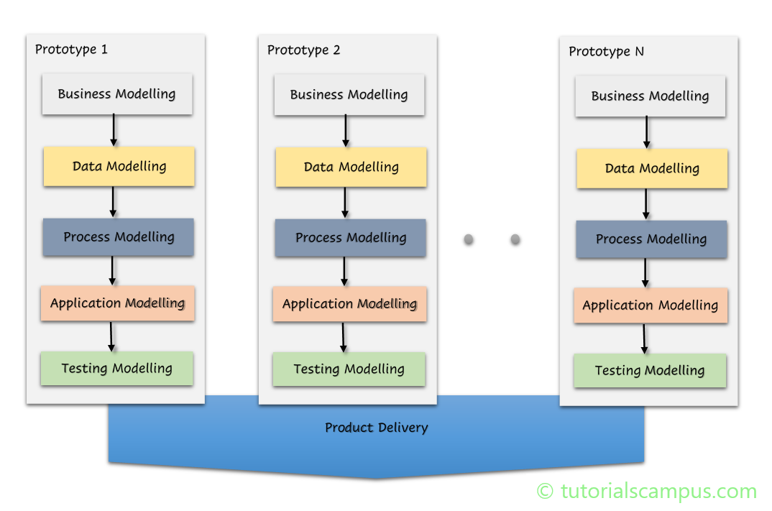
Diagram

Slide 4
Model phases
Business Modeling
Data Modeling
Process Modeling
Application Generation
Testing and Turnover

Slide 5
1.Business Modelling
The information flow among business functions is defined by answering questions like what data drives the business process, what data is generated, who generates it, where does the information go, who process it and so on.

Slide 6
2. Data Modelling
The data collected from business modelling is refined into a set of data objects (entities) that are needed to support the business. The attributes (character of each entity) are identified, and the relation between these data objects (entities) is defined.

Slide 7
3. Process Modelling
The information object defined in the data modeling phase are transformed to achieve the data flow necessary to implement a business function. Processing descriptions are created for adding, modifying, deleting, or retrieving a data object.

Slide 8
4. Application Generation
Automated tools are used to facilitate construction of the software; even they use the 4th GL techniques.

Slide 9
5. Testing & Turnover
Many of the programming components have already been tested since RAD emphasis reuse. This reduces the overall testing time. But the new part must be tested, and all interfaces must be fully exercised.

Slide 10
Advantages of RAD Model
This model is flexible for change.
In this model, changes are adoptable.
Each phase in RAD brings highest priority functionality to the customer.
It reduced development time.
It increases the reusability of features.

Slide 11
Disadvantages of RAD Model
It required highly skilled designers.
All application is not compatible with RAD.
For smaller projects, we cannot use the RAD model.
On the high technical risk, it's not suitable.
Required user involvement.

Slide 12
THANK YOU

